Slide 1

Python! Day 22
Continue learning about tkinter
Create a password manager application

Slide 2
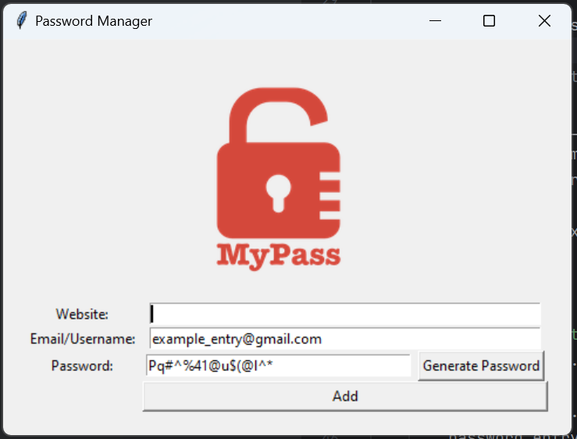
Project: Password Manager
Today, let’s use tkinter to make a password manager program
This program will pull up a window that allows the user to enter the website name, email/username, and password that the program will save onto a txt file
To do this, we’ll have to use some of the tkinter stuff we used last week, and we’ll also have to learn some new stuff

Slide 3
Step 1: Setup
First, let’s create our project folder and new python project
After we open up our main.py file, we’ll need to get the lock image to add to our screen
Let’s get the image by downloading it from my 4-23 GitHub branch and dragging the file into our new project
https://github.com/Tavishi27/Tuesday-Python-Files
Now let’s import tkinter into our main.py file
We can write from tkinter import * instead of import tkinter, so we don’t have to write tkinter when creating tkinter objects

Slide 4
Step 1: Setup
Next, we’ll want to create a window
Since we imported all of tkinter with the *, our code will look like this:
from tkinter import *
window = Tk()
window.title(“Password Manager”)
window.mainloop()

Slide 5

Step 2: Adding the Logo
Next, let’s add the lock image to the window
To do this, we’ll need to learn about the tkinter canvas widget
The canvas widget allows us to add images to the window and even overlap images and text
We can’t overlap things without canvas because the layout management tools we learned about last week will prevent it
If we go to the logo.png file, we can see that the image is 200 x 189 pixels, so let’s create a 200 x 200 canvas to display the image

Slide 6

Step 2: Adding the Logo
Let’s create a canvas like this:
canvas = Canvas(width=200, height=200)
Next, we’ll need to create a PhotoImage object to use the logo.png file:
logo_img = PhotoImage(file=“logo.png”)
Now, we need to use the canvas.create_image() function to add the image to the canvas:
canvas.create_image(100, 100, image=logo_img)
The first 2 inputs indicate the coordinates on the canvas where we want to place the image
Finally, we can use canvas.pack() to see the canvas on the screen
Let’s also use the window.config() function to add 20 pixels of padiing to the window

Slide 7
from tkinter import * # Add UI window = Tk() window.title("Password Manager") window.config(padx=20, pady=20) canvas = Canvas(width=200, height=200) logo_img = PhotoImage(file="logo.png") canvas.create_image(100, 100, image=logo_img) canvas.pack() window.mainloop()

Slide 8
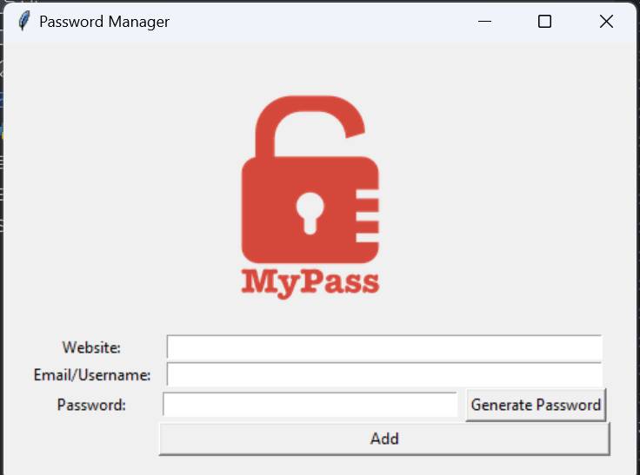

Step 3: Creating the Rest of the UI Layout
Next, we’ll need to create all of the other features of the program to finish the UI layout of the program
But to do this, we’ll need to learn how to use the grid to make some features span multiple columns
For example, the website entry is the 2nd and 3rd column
We can do this by adding a column span input to our grid() function
Like this:
entry.grid(column=1, row=1, columnspan=2)

Slide 9
width=55
width=55
width=37
width=14
width=48

Slide 10
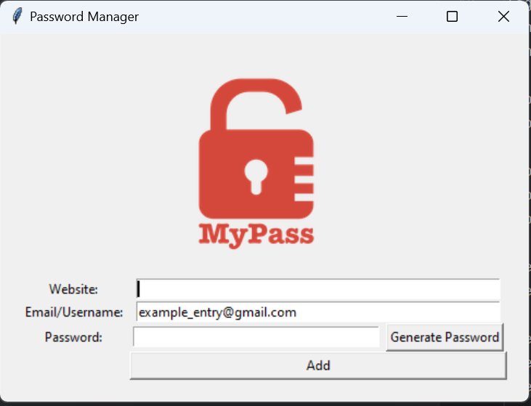
Step 4: Small Details
Before moving on to the next step, let’s add a couple of small details to the project
Let’s make the cursor automatically start in the website entry box, and let’s automatically fill in the entry box with an example email
This might look like:
website_entry.focus()
username_entry.insert(0, example_email@gmail.com)

Slide 11
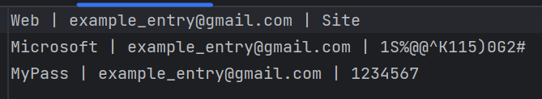
Step 5: Add the Data to a data.txt file
Next, we’ll want to add the data to a data.txt file when the user presses the add button
First, let’s create a function called save() and add it as a command input to our add button:
def save():
print(“hi”)
add_button = Button(text=“Add”, command=save)

Slide 12
Step 5: Add Data to a data.txt File
Next, we’ll want to use our file knowledge to add our website, username, and password to a data.txt file in the save() function
Like this:
def save():
website = website_entry.get()
username = username_entry.get()
password = password_entry.get()
with open("data.txt", "a") as data_file:
data_file.write(website + " | " + username + " | " + password + “\n”))

Slide 13
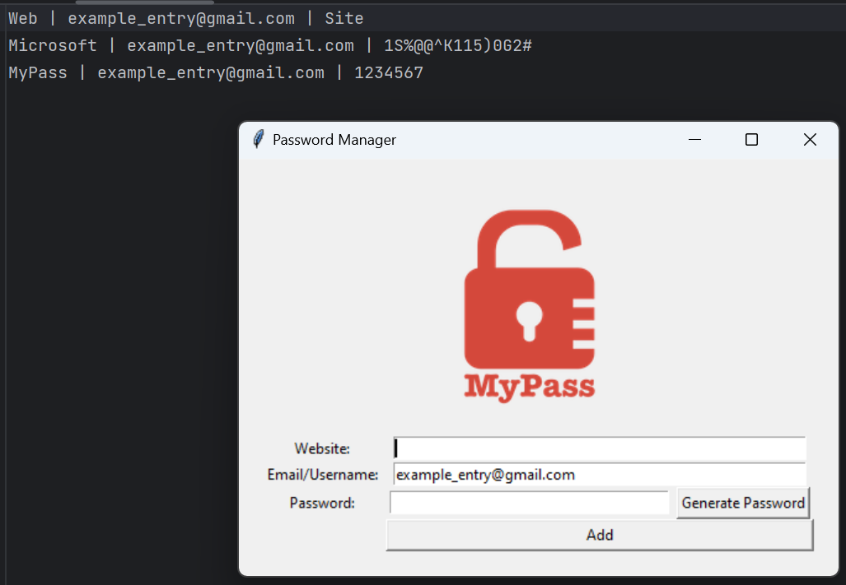
Step 6: Empty the Website and Password Entries
Next, we should give the user an indication that the data has been recorded when the add button is pressed by emptying the website and password entries
Like this:
website_entry.delete(0, END)
password_entry.delete(0, END)

Slide 14
# Save the data to data.txt def save(): website = website_entry.get() username = username_entry.get() password = password_entry.get() with open("data.txt", "a") as data_file: data_file.write(website + " | " + username + " | " + password + "\n") website_entry.delete(0, END) password_entry.delete(0, END)

Slide 15
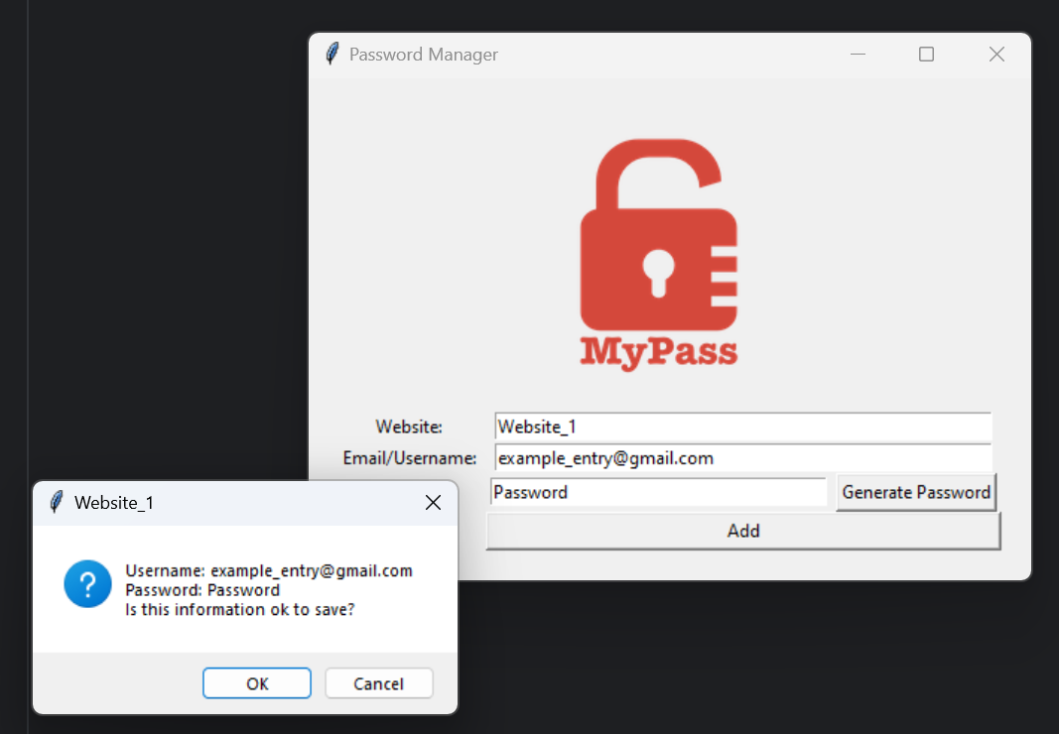
Step 7: Add a Confirmation Popup
Next, when the user presses the add button, let’s show them a popup asking if the information is correct and if they want to confirm
We can do this by importing the messagebox module from tkinter:
from tkinter import messagebox
Next, we can create an askokcancel messagebox that will ask the user to press “okay” or “cancel”
is_ok = messagebox.askokcancel(title=website, message=“Username: ” + username + “\n Password: ” + password + “/n Is this information ok to save?”)
Now, we’ll only want to save the data if is_ok is True

Slide 16
def save(): website = website_entry.get() username = username_entry.get() password = password_entry.get() is_ok = messagebox.askokcancel(title=website, message="Username: " + username + "\nPassword: " + password + "\nIs this information ok to save?") if is_ok: with open("data.txt", "a") as data_file: data_file.write(website + " | " + username + " | " + password + "\n") website_entry.delete(0, END) password_entry.delete(0, END)

Slide 17
Step 8: Generate a Password
Next, let’s create a generate password function that goes as the command input to the generate password button
def generate_password():
print(“hi”)
generate_password_button = Button(text=“Generate Password”, command=generate password)
Now, let’s write some code that uses the random module and loops to generate a password in our generate password function
The generate password function should also clear the password entry box and insert the randomly generated password in the box

Slide 18
# Generate a password letters = ["a", "b", "c", "d", "e", "f", "g", "h", "i", "j", "k", "l", "m", "n", "o", "p", "q", "r", "s", "t", "u", "v", "w", "x", "y", "z"] symbols = ["!", "@", "#", "$", "%", "^", "&", "*", "(", ")"] def generate_password(): password_entry.delete(0, END) password = "" for n in range(0, 15): num = random.randint(1, 3) if num == 1: # add a letter letter = random.choice(letters) upper = random.randint(0, 1) if upper == 1: letter = letter.upper() password += letter elif num == 2: # add a symbol password += random.choice(symbols) elif num == 3: # add a number password += str(random.randint(0, 9)) password_entry.insert(0, password)

Slide 19

Step 9: Extra Features
These are optional, but some extra features we can add to our program are:
Popup that prevents the user from leaving the website or password box empty
Code that copies the password to the clipboard when the user presses the generate password button using the pyperclip module
Google the pyperclip documentation to figure out how
Fix the UI layout spacing if it’s messed up

Slide 20

Finished Password Manager!

